Slide 1
Safety and Adverse Event Characterization of Type 2 Diabetes Treatments
Team: Jet2 Holiday
Jiayi Chu, Runjiu Chen, Shuya Guo, Yixin Xue
12/11/2025

Slide 2
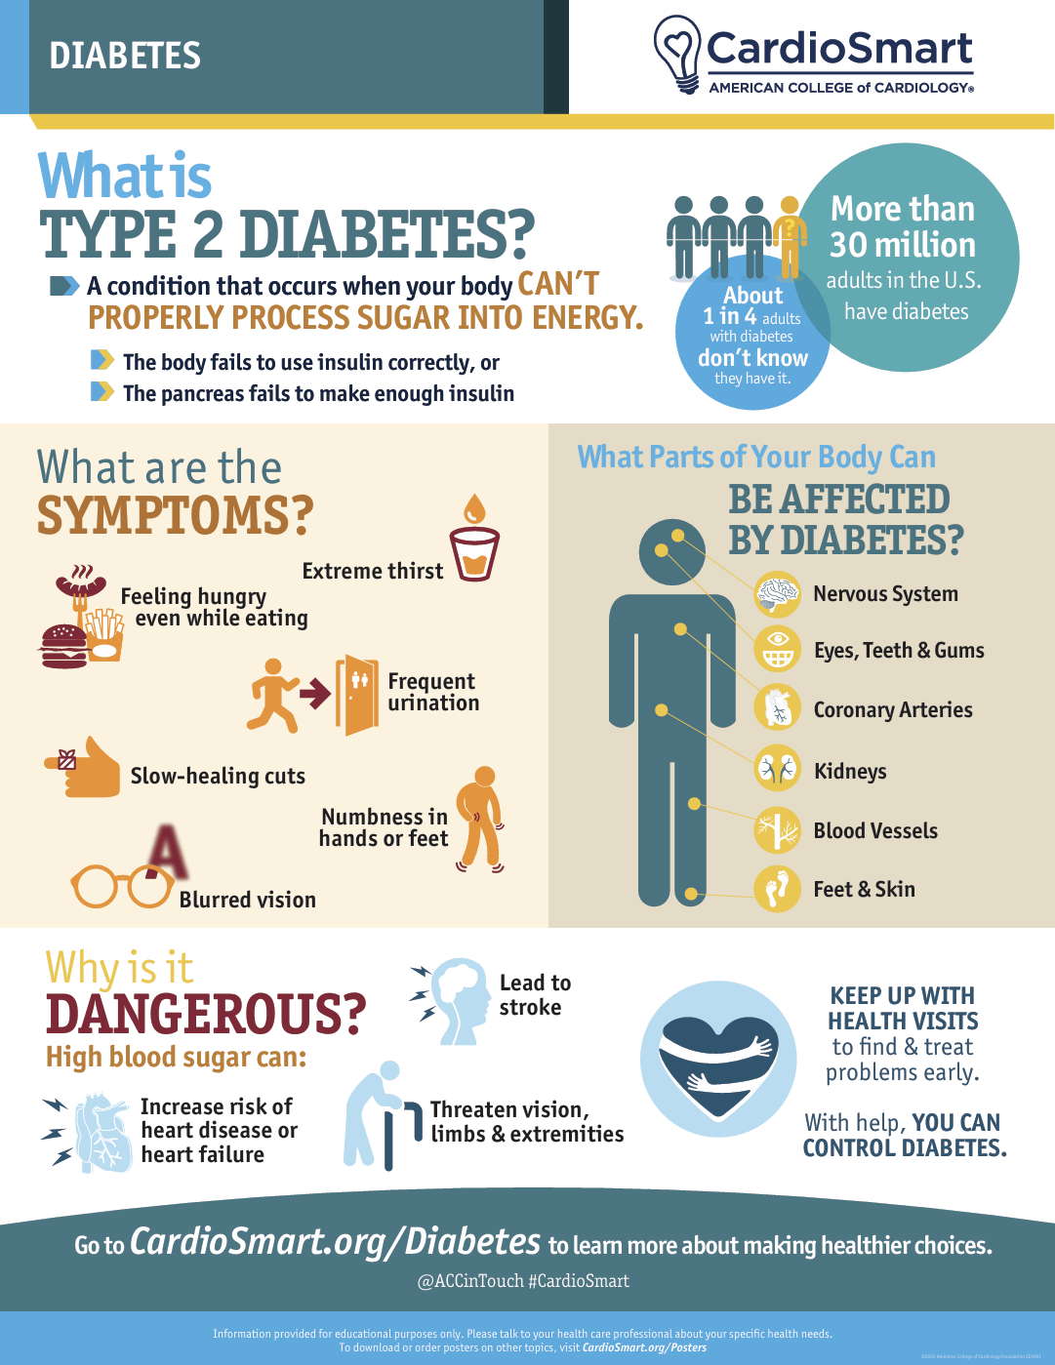
Background
Type 2 diabetes requires long-term pharmacologic management across multiple drug classes ○ Different medications have distinct mechanisms and different adverse event profiles
Real-world safety data ○ FAERS (FDA Adverse Event Reporting System) collects millions of spontaneous adverse event reports, including patient demographics, drug exposures, and MedDRA-coded clinical events
Medication complexity ○ Newer therapies (e.g., GLP-1 RA, SGLT2 inhibitors) are increasingly prescribed alongside older agents (metformin, DPP-4 inhibitors, insulin)
Notes:
给reference

Slide 3
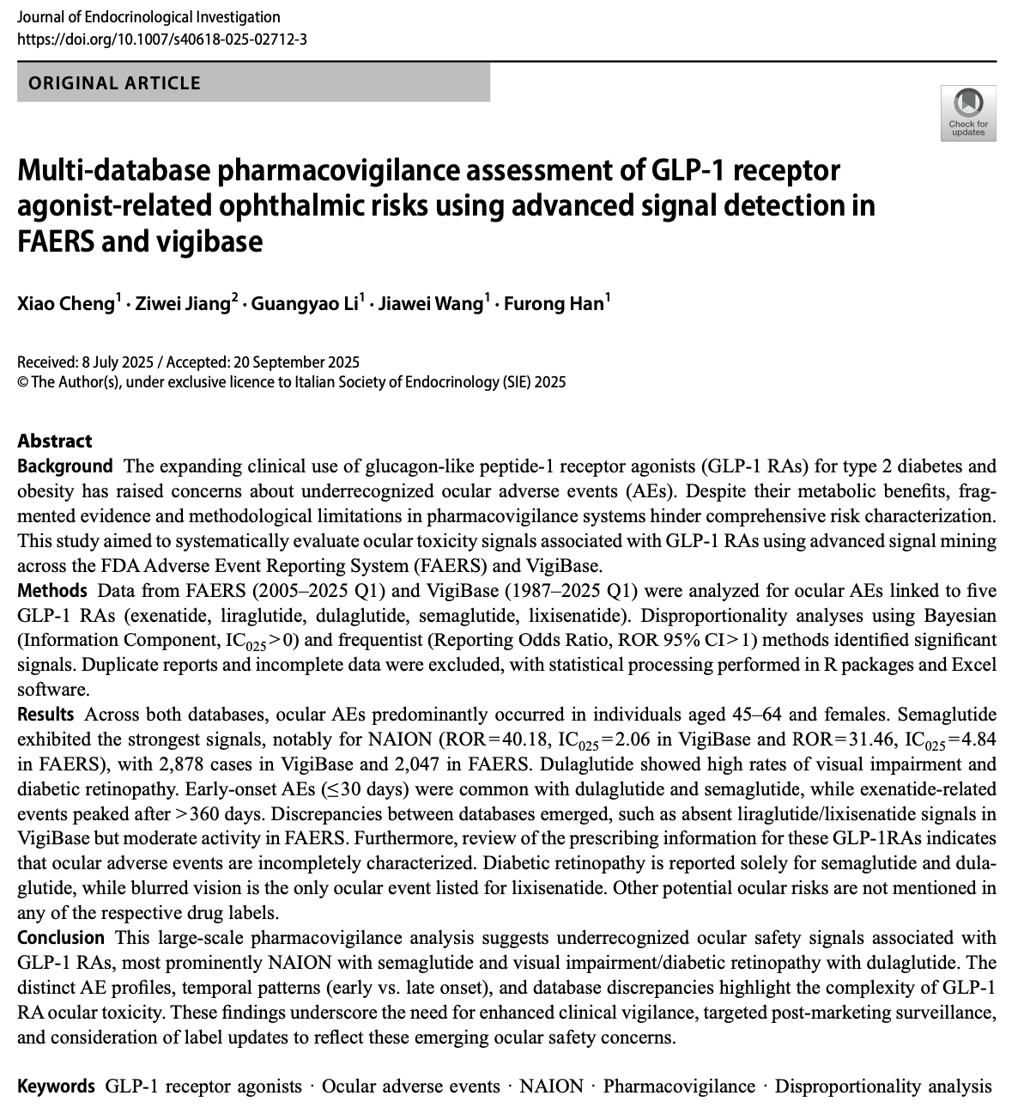
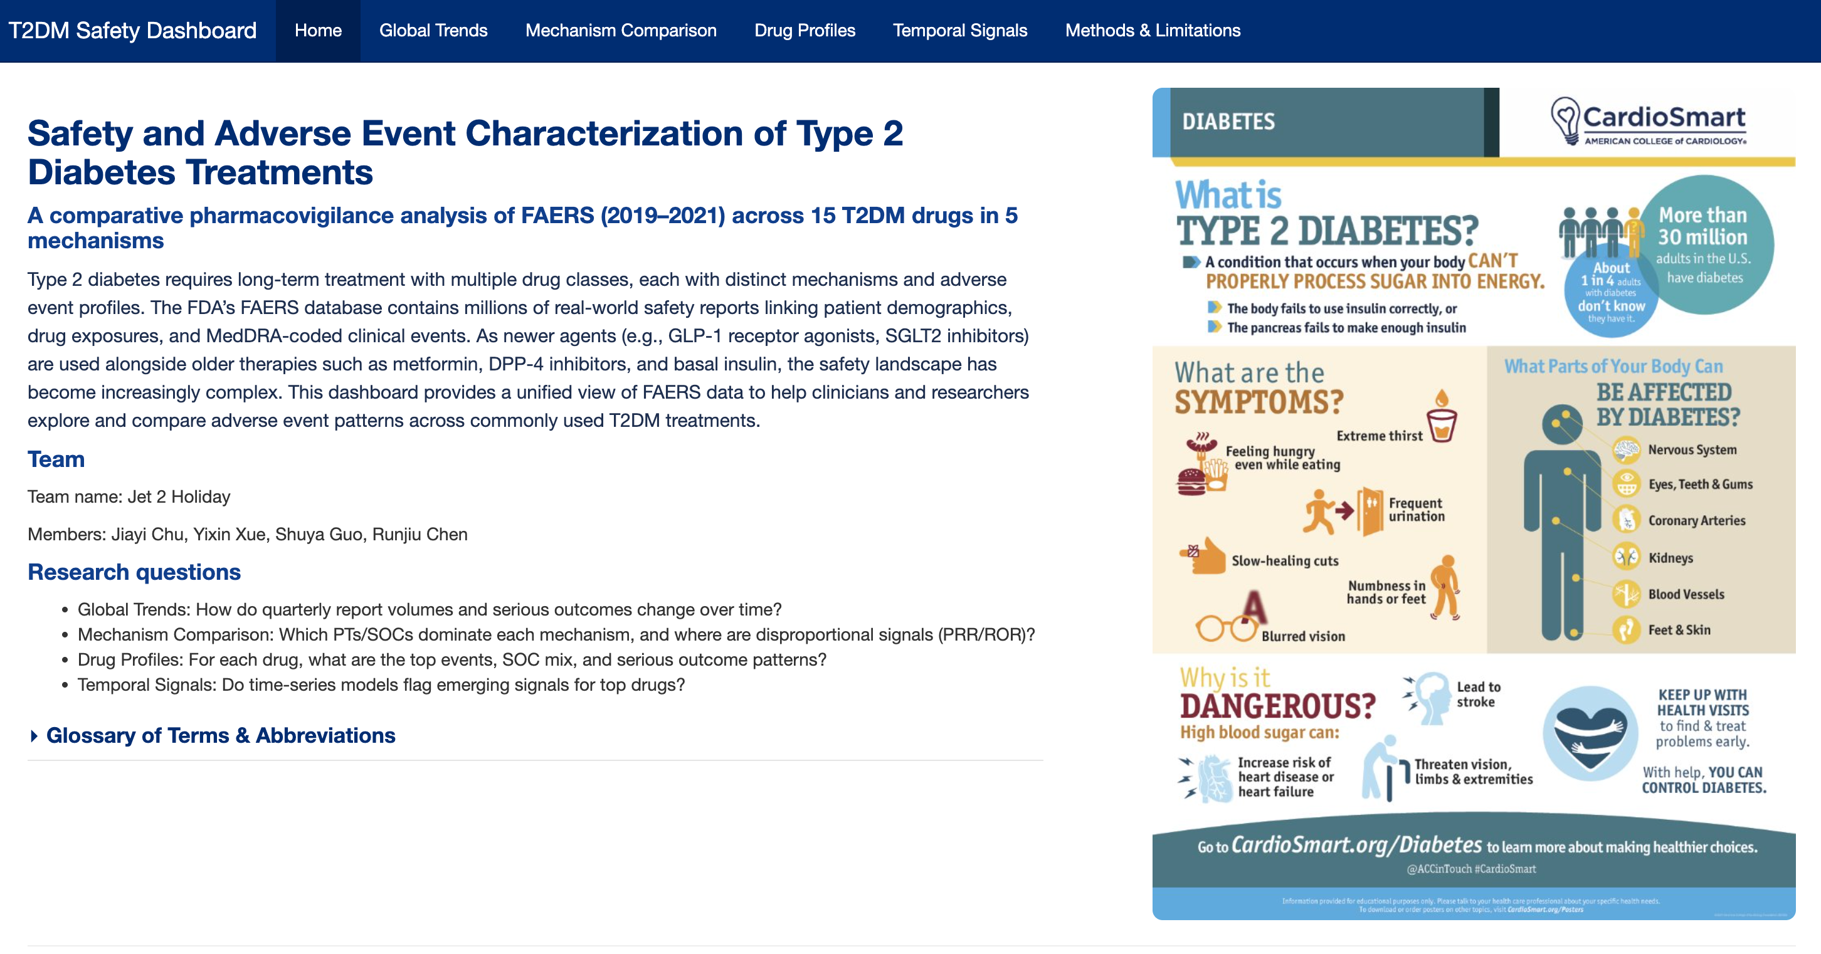
Exsiting Work
FAERS widely used for T2DM safety studies
Prior studies focus on one drug or one outcome
Confirms FAERS is suitable, but tools remain fragmented
Our project fills the gap with cross-class, unified analysis
Source: Cheng et al., 2025

Slide 4
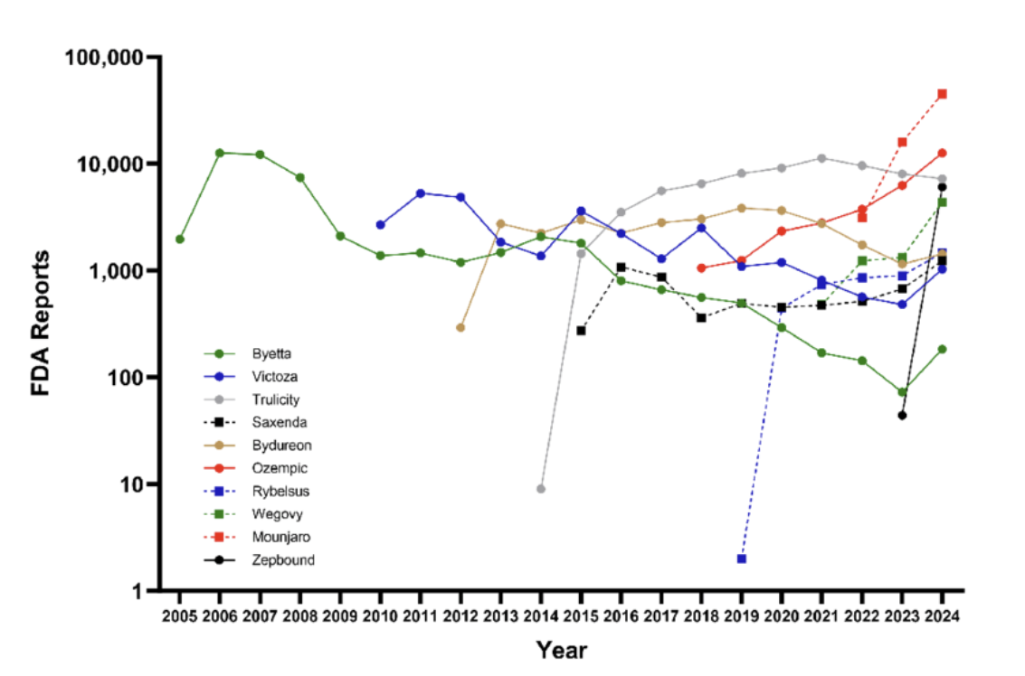
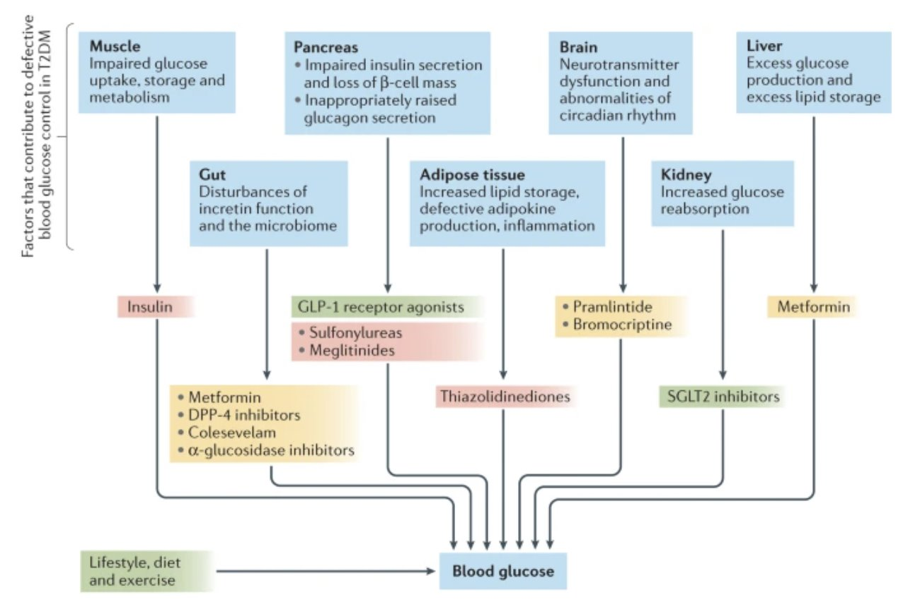

Project Objective
Annual FDA Adverse Event Reports for GLP-1 and Related Metabolic Medications, 2005–2024
To build a scalable, automated R-based workflow and Shiny dashboard that:
Integrates FAERS data across 2019–2021
Standardizes drug names and MedDRA（Medical Dictionary for Regulatory Activities）terms
Quantifies adverse event patterns across five major T2DM drug classes
Identifies class-level and drug-level safety signals
Provides interpretable visualizations and trend monitoring for clinicians and researchers
Source: Bhattacharyya et al., 2024

Slide 5
Study Design
Design: Retrospective observational pharmacovigilance study
Data: FAERS quarterly reports (2019–2021)
Population: Reports with primary suspect exposure to 15 T2DM drugs
Exposure: Drug–event records grouped by ATC(Anatomical Therapeutic Chemical)-based mechanistic class
Outcomes: Adverse events summarized using pre-defined SOC categories derived from MedDRA PTs
Analysis: Descriptive summaries, PRR/ROR disproportionality, and temporal trend analysis
Notes:
For our study design, we used FAERS reports from 2019 to 2021.
We looked at cases where a type 2 diabetes drug was the main suspected medication.
We grouped each drug and its reported events by their mechanism class, so we could compare classes instead of single drugs.
We summarized adverse events using broader categories based on MedDRA terms.
To analyze safety patterns, we used simple descriptive summaries, looked at whether some events were reported more often with PRR and ROR, and checked basic time trends across classes.

Slide 6
Our Data：
Data Source
FAERS quarterly ASCII datasets (2019–2021).
Programmatically downloaded and unzipped quarterly FAERS ASCII datasets (2019–2021), organized by year and quarter.
Data Standardization and Deduplication
Standardized column names across all FAERS tables.
Cleaned field contents (trim strings, normalize case, parse dates, bound numeric values).
Deduplicated reports by keeping the latest case version per CASEID.
Imported cleaned FAERS tables into a relational SQLite database.
Database Integration and Validation
Imported cleaned FAERS tables into a relational SQLite database.
Performed in-database cleaning to remove implausible dates and values (e.g., age < 0 or > 120; event_date > death_date).

Slide 7
Our Data：
Target Drug Identification and Normalization
Identified target T2DM drugs using keyword-based wide screening.
Normalized drug names using the RxNorm API with local caching.
Filtered to primary suspect (PS) reports for 15 target T2DM drugs.
Adverse Event Classification
Mapped MedDRA Preferred Terms (PT) to pre-defined System Organ Class (SOC) categories.
Cohort Construction and Analytic Integration
Assembled case-level cohort tables (demographics, drugs, reactions, outcomes).
Added ATC codes and mechanistic class labels to each drug exposure.
Integrated all components into a final analytic table for downstream analysis.

Slide 8
Paradigm Integration：
Command-line execution: Enables automated, large-scale processing of FAERS data through batch execution of the full pipeline
Functional programming: Supports modular and composable data transformations for cleaning, integrating, and summarizing drug–event data
Database programming: Uses a relational database to efficiently store, index, join, and aggregate large pharmacovigilance datasets
Machine learning / Time series analysis: Applies time-series and machine learning methods to explore temporal patterns and emerging safety signals
Notes:
Our project integrates multiple programming paradigms. We automated FAERS data ingestion using command-line scripts, which ensured a fully reproducible pipeline. Functional programming with dplyr and purrr allowed us to build reusable cleaning and processing functions. We used object-oriented structures to encapsulate drug-level summaries and generate consistent plots and tables.
For temporal trends, we applied machine-learning forecasting methods like ARIMA and Prophet. Finally, reactive programming in Shiny tied everything together, allowing real-time filtering, SQL queries, and interactive visualizations. This combination of paradigms reflects the full scope of modern data engineering and analysis in R.

Slide 9
Technical Challenges
Large database size: Processing multi-million FAERS records required database-backed cleaning to overcome memory constraints
Drug name normalization via external APIs: Integrating the RxNorm API to standardize heterogeneous drug names while handling rate limits, network latency, and caching for reproducibility
Adverse event classification without licensed MedDRA SOC: Due to lack of access to the official MedDRA PT–SOC mapping, we constructed a custom, literature-informed SOC mapping to enable organ-level analysis
Notes:
“We also faced several technical challenges when building the system.
The first is the large database size. FAERS includes multi-million reports, so reading everything directly into R would exceed memory. To solve this, we pushed most operations into the database layer, enabling scalable processing.
The second challenge is drug name normalization. FAERS drug names are extremely heterogeneous—different spellings, abbreviations, brand vs generic. We integrated the RxNorm API to standardize names, but had to manage API rate limits, network delays, and caching for reproducibility.
The third challenge is adverse event classification without official MedDRA SOC. Because MedDRA is licensed and we could not directly access the PT–SOC mapping, we had to build our own SOC dictionary from literature and expert-informed mappings so that organ-level analysis is still possible.
These challenges shaped how we designed the final pipeline.”

Slide 10
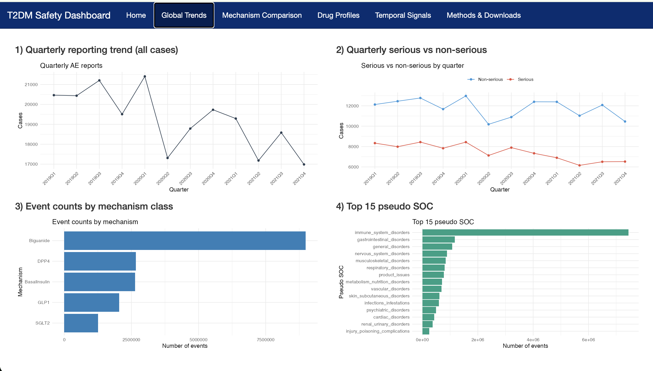
Global Trends :

Slide 11
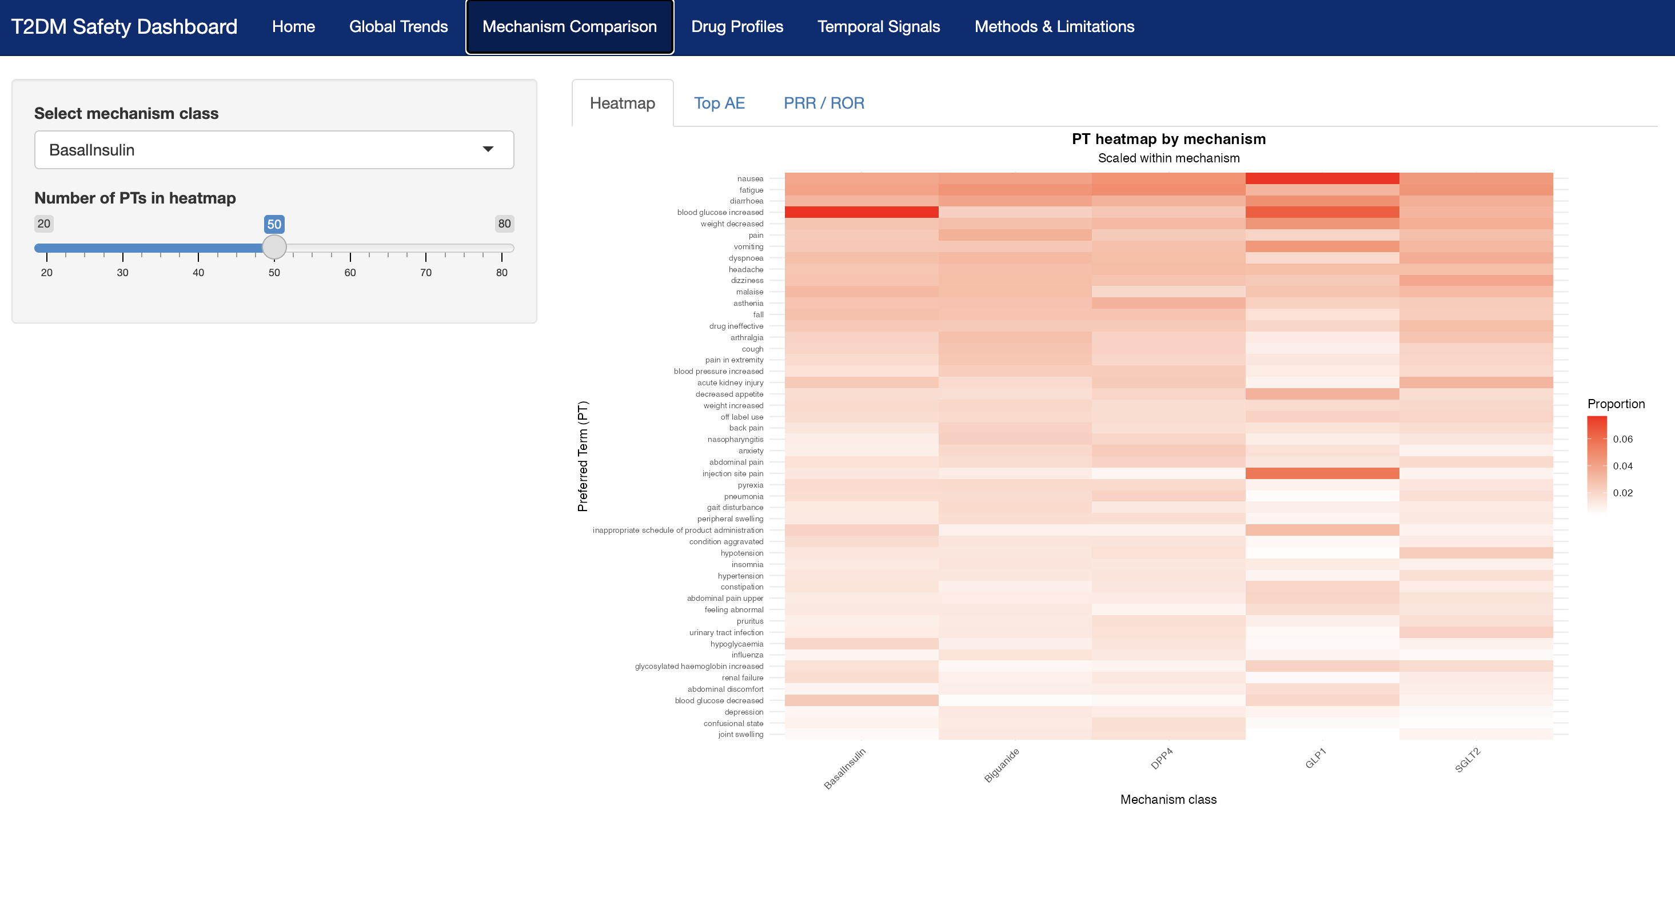
Mechanism Comparison :
Notes:
Next, I’ll walk through the mechanism comparison section of our dashboard. This page helps users see how adverse events differ across major diabetes drug classes. The heatmap on the right shows how often different events appear in each class. Users can adjust how many PTs are shown, so they can focus on the most common events or look at a wider set. From this view, we can already see clear differences. For example, GLP-1 drugs have more stomach-related events, while SGLT2 inhibitors show more metabolic and infection-related events.

Slide 12
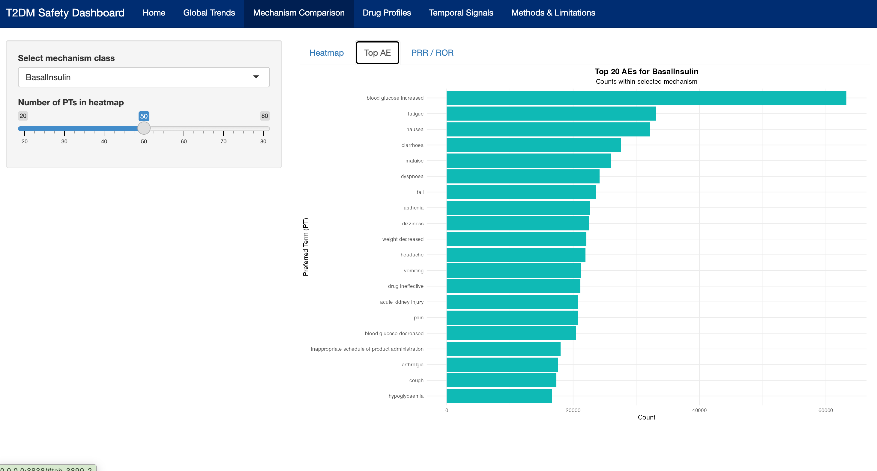
Mechanism Comparison :
Notes:
The second tab shows the top reported events for each drug class. Users can choose a class on the left, and the list updates right away.
This gives a quick idea of what clinicians might actually see in practice and helps highlight which events stand out the most.

Slide 13
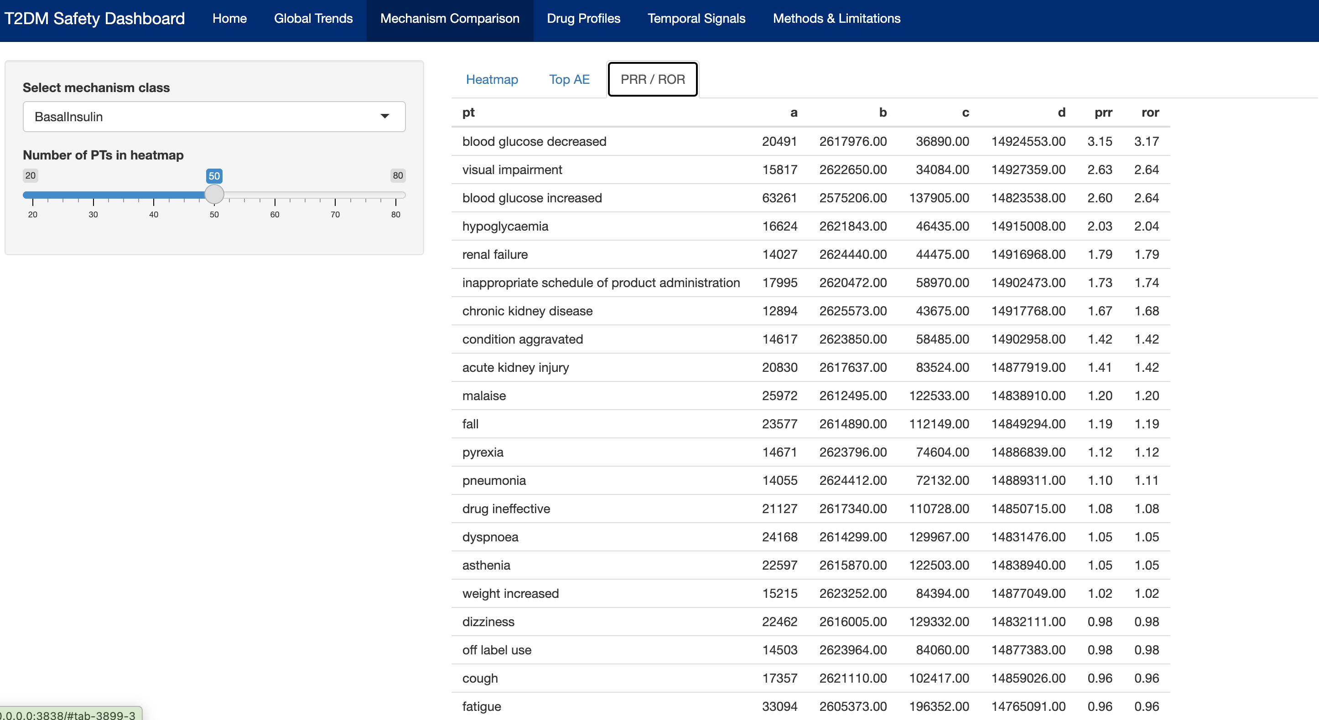
Mechanism Comparison :
a = Number of reports from the selected mechanistic class that include this Preferred Term (PT).
b = Number of reports from the selected mechanistic class that do not include this PT.
c = Number of reports from all other mechanistic classes that include this PT.
d = Number of reports from all other mechanistic classes that do not include this PT.
 | PT reported | PT not reported
Selected mechanistic class | a | b
All other classes | c | d
Notes:
The last tab shows PRR and ROR values. These help us see whether certain events are reported more often for one class compared with others.
These numbers support the earlier plots and point to events that match known clinical risks.

Slide 14
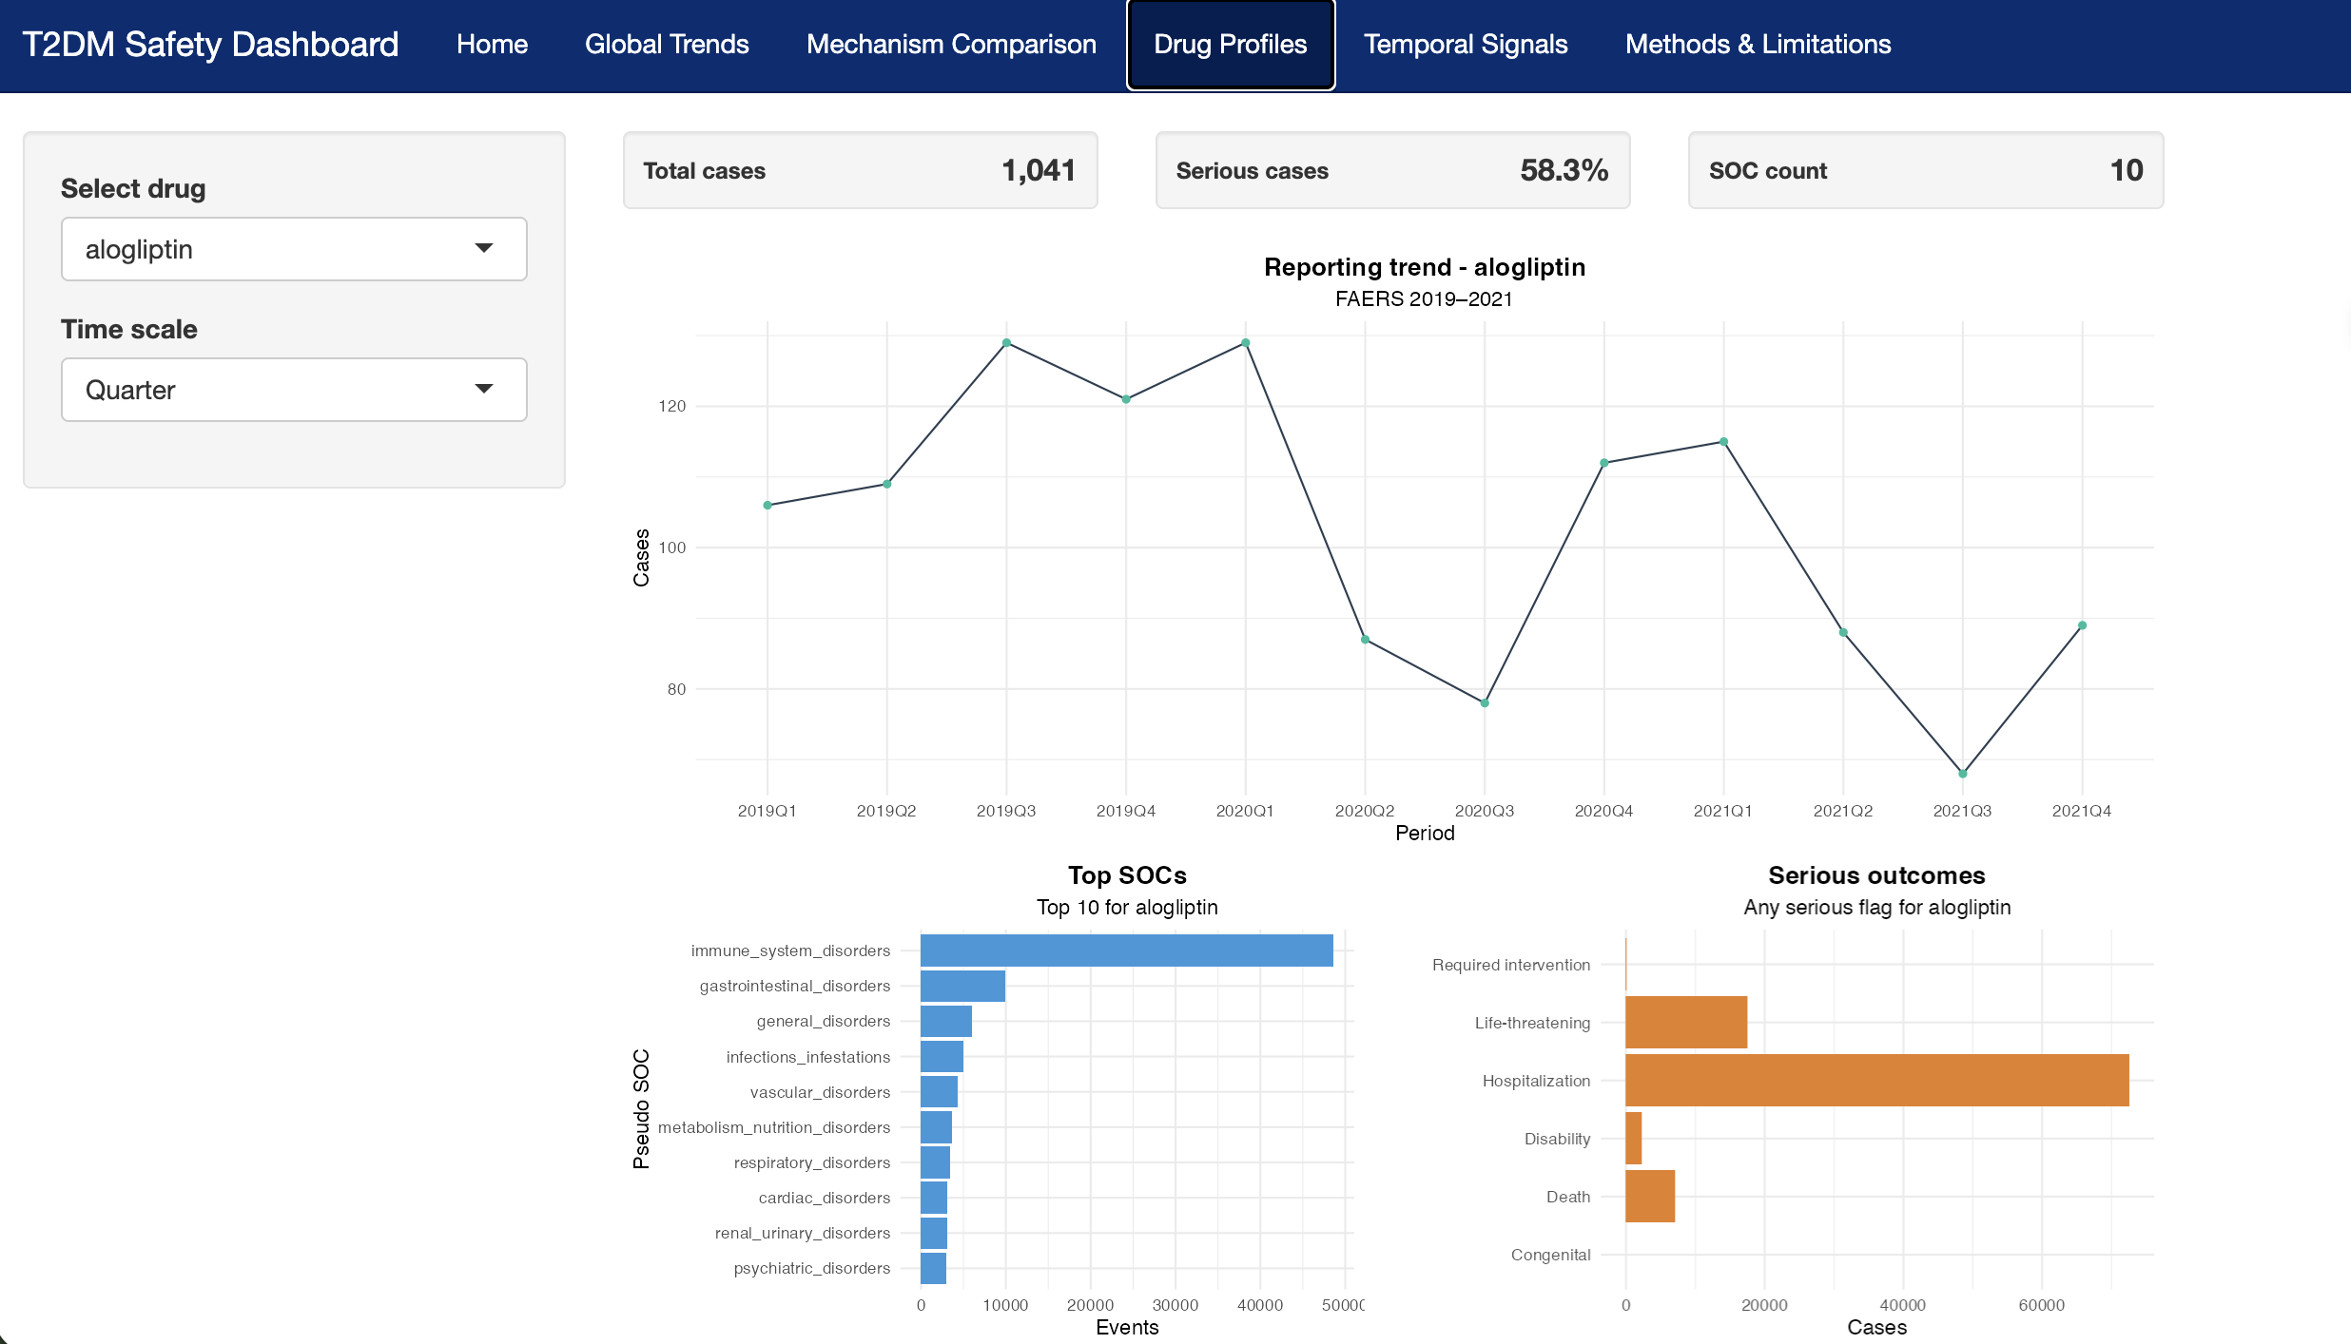
Individual Drug Profiles :

Slide 15
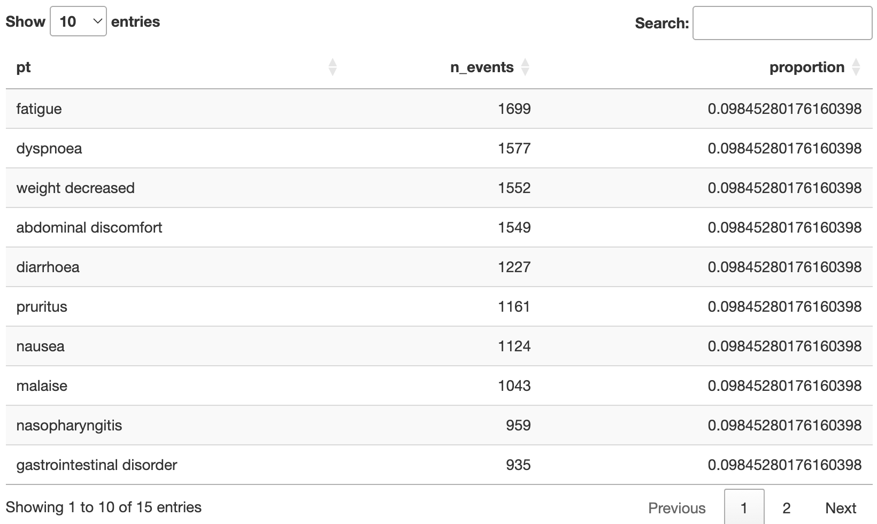
Individual Drug Profiles :

Slide 16
Interactive Multi-Model Forecasting
Why This Matters
FAERS adverse event reports show important temporal patterns that may indicate emerging safety risks.
Current tools lack flexible, model-based forecasting for monitoring these patterns.
Project Goal
Build an interactive forecasting dashboard for high-volume drugs in FAERS.
Allow users to compare multiple prediction models
Identify increasing, stable, or abnormal reporting trends.
What We Deliver
A real-time Quarto + Shiny interface.
Multi-model forecasts visualized side-by-side.
A framework supporting early signal detection in pharmacovigilance.
Notes:
Today I’ll introduce our interactive multi-model forecasting tool for FAERS adverse event data. FAERS reports contain rich temporal patterns, and some of these changes—especially sudden increases—may indicate emerging safety risks.
However, existing monitoring tools are mostly descriptive and do not provide model-based forecasting. So our goal was to build an interactive dashboard that allows users to explore time-series trends for high-volume drugs and compare multiple forecasting models side-by-side.
This helps us identify increasing, stable, or abnormal patterns, and provides a framework that could eventually support early safety-signal detection.

Slide 17
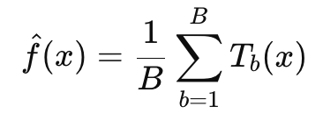
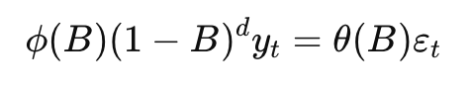
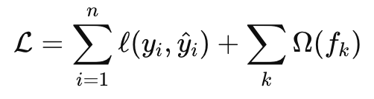
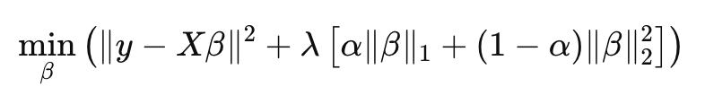
Machine Learning Methods Introducing
Model | Type | Purpose
ARIMA | Statistical | Captures trend + seasonality; Reduces flat-line failures
XGBoost | Machine learning | Powerful nonlinear fit; Uses time index+quarter as features
Random Forest | ML ensemble | Handles nonlinearities; Robust to noise
Elastic Net | ML regression | Balances L1/L2; Prevents overfitting
Notes:
We included four complementary forecasting approaches.
First, ARIMA, a classical statistical model, captures trend and seasonality through differencing and autoregressive structure. It provides a strong baseline but tends to fail when the data have irregular quarter-to-quarter changes.
Second, XGBoost, which uses nonlinear boosting trees. It captures sharp fluctuations and complex temporal patterns by learning from time index and quarter features.
Third, Random Forest, an ensemble of decision trees. It is more noise-robust but may underfit long-term trends or overfit small fluctuations.
Finally, Elastic Net, a linear model with combined L1/L2 regularization. It performs well when the underlying trend is approximately linear and provides stable, interpretable predictions.
Together, these models allow us to test different assumptions about the data and evaluate forecasting behavior across drug classes.

Slide 18
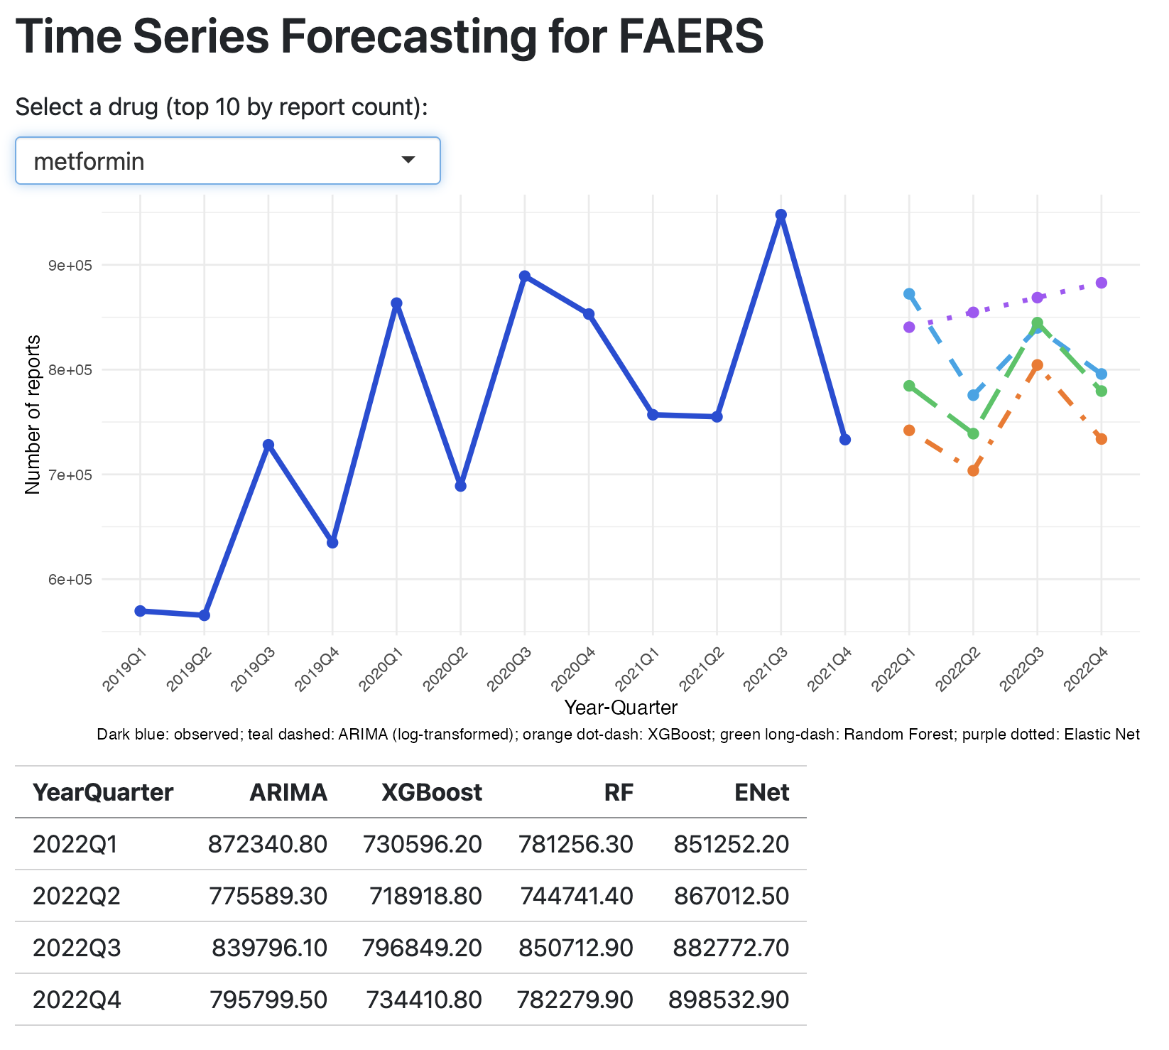
Dashboard & Function
Dashboard Features
Real-time model comparison Drug selection (Top 10) Multi-model forecast overlay Clean, modern UI (Quarto + Shiny) Forecast table for next 4 quarters
Visual Output Example
Deep blue = Observed
Teal dashed = ARIMA
Orange dot-dash = XGBoost
Green long-dash = Random Forest
Purple dotted = Elastic Net
18
Notes:
We implemented the tool using Quarto and Shiny to enable real-time model comparison. Users can select any of the top 10 most frequent drugs in FAERS. The dashboard then automatically pulls the time-series data, fits all four models, and visualizes the observed trend along with each model’s 4-quarter forecast.
The interface is minimal and clean. Deep blue shows the observed data; teal, orange, green, and purple represent ARIMA, XGBoost, Random Forest, and Elastic Net respectively.
Below the plot, we include a forecast table summarizing numerical predictions for more precise comparison.

Slide 19
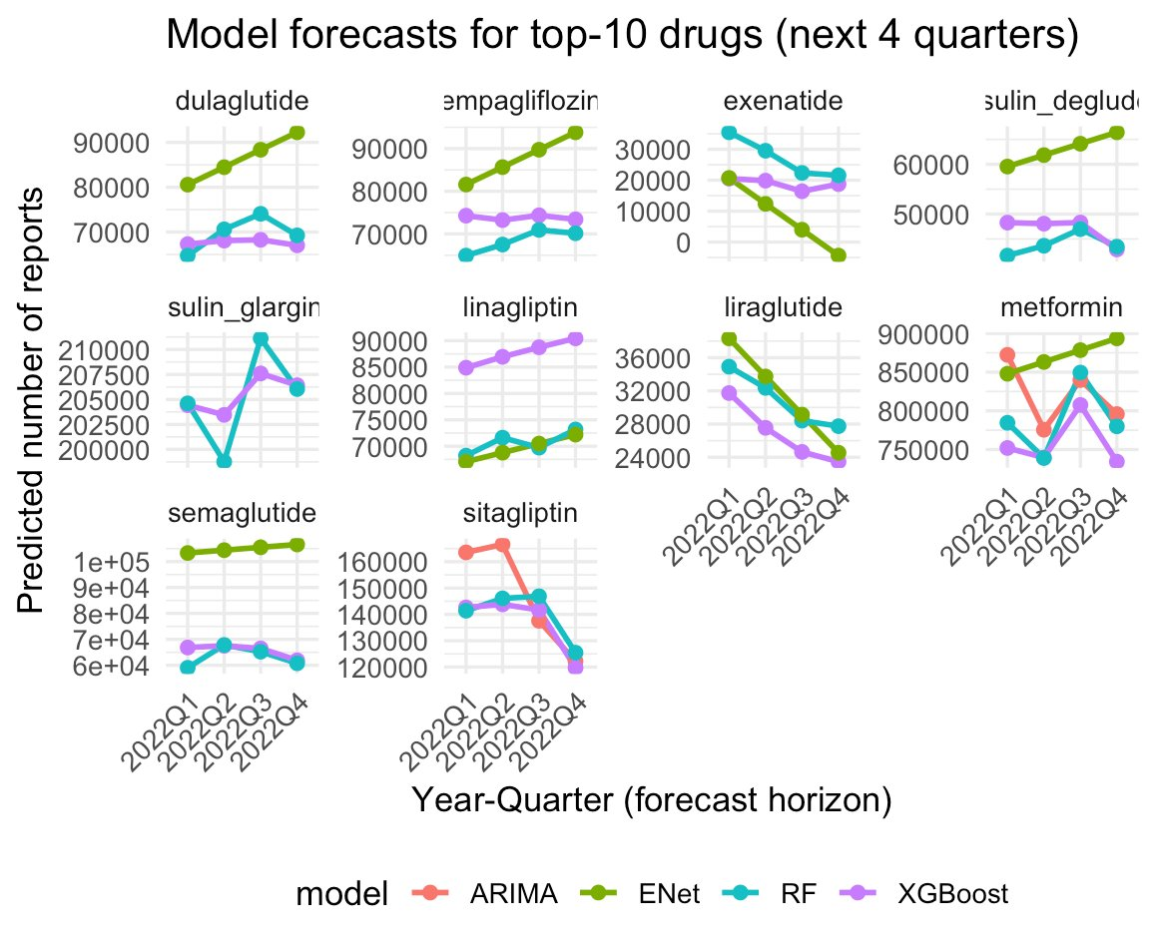
Model Performance Across Top FAERS Drugs
XGBoost -- the most reliable forecasts across drugs. Nonlinear patterns, adapted to irregular quarter-to-quarter fluctuations, Avoided the “flat-line” failures seen in classical models.
Elastic Net -- a stable and interpretable baseline. Performed well when the underlying drug trend was approximately linear, Less flexible for drugs with sudden changes or nonlinear trajectories.
Random Forest -- mixed performance.
Captured some nonlinearities
tended to overfit
ARIMA -- the least effectively. Flat or overly conservative forecasts
Failed to adapt to genuine upward or downward trends.
19
Notes:
We also examined model performance across the top 10 drugs.
Overall, XGBoost produced the most reliable forecasts. It adapted to irregular quarter-to-quarter changes and avoided the “flat-line” failures seen in some classical models.
Elastic Net performed well for drugs with approximately linear trends, providing stable forecasts but becoming less flexible when sudden changes occurred.
Random Forest showed mixed performance—sometimes capturing nonlinearities, but other times overfitting noise or underfitting long-term patterns.
Finally, ARIMA was the least effective. It often produced flat or overly conservative forecasts and struggled to follow genuine upward or downward trajectories.
These results highlight that no single model fits all drugs, but XGBoost offers the best overall adaptability for FAERS time-series patterns.

Slide 20
What We Learned：
Working with Large, Real-World Data is Hard
Importance of Standardization
Collaboration makes the work better
Building something people can use feels different from just coding
We became more confident working with ambiguity
20
Notes:
So before we finish, here are a few things we picked up while working on this project. We learned how to work with messy, real-world data, how to divide tasks effectively, and how to turn technical work into something people can actually use. Most importantly, we became more confident handling ambiguity and making analytic decisions together.

Slide 21
Thank You!
Jet2 Holiday

